Slide 1
QUALITATIVE ANALYSIS
TESTING FOR CATIONS

Slide 2
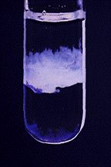
Calcium (Ca²⁺)
Test with aqueous sodium hydroxide
White ppt. insoluble in excess
Test with aqueous ammonia
No ppt. or very slight white ppt.

Slide 3
Calcium ions:
Ca²⁺_{(aq)} + 2OH⁻_{(aq)} → Ca(OH)_{2(s)} white ppt.
The ppt. is not soluble in excess of NH₃
or NaOH.
The test for Mg²⁺ and Ca²⁺ have similar tests and similar
results.
You could distinguish Mg from Ca with a flame test

Slide 4
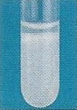
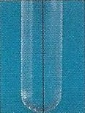
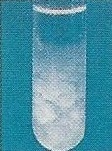
Test for Cations – Ca²⁺ / Pb²⁺ / Zn²⁺
Observation:
White ppt. observed.
Observation:
White ppt., soluble in excess, giving a colourless solution.
Conclusion:
Pb²⁺ / Zn²⁺ is present.
Observation:
White ppt., insoluble in excess.
Conclusion:
Ca²⁺ is present.

Slide 5
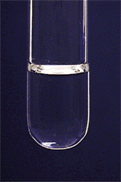
Aluminium(Al³⁺) Ions
Test with aqueous sodium hydroxide Solution
White ppt. soluble in excess giving a colourless solution
Test with aqueous ammonia Solution
White ppt. insoluble in excess
Al³⁺ +3OH⁻ →Al(OH)₃(s) in excess
NaOH forms soluble (Al(OH)₄⁻

Slide 6
Zinc (Zn²⁺) Ions
Test with aqueous sodium hydroxide Solution
White ppt. soluble in excess giving a colourless solution
Test with aqueous ammonia Solution
White ppt. Soluble in excess
⁻
Zn²⁺_{(aq)} + 2OH⁻_{(aq)} → Zn(OH)_{2(s)} white ppt. The ppt. dissolves in both excess
sodium hydroxide and ammonia to give a clear colourless solution.

Slide 7
Lead (Pb²⁺) Ions
Test with aqueous sodium hydroxide Solution
White ppt. soluble in excess giving a colourless solution
Test with aqueous ammonia Solution
White ppt. Soluble in excess
⁻

Slide 8
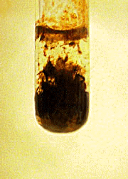
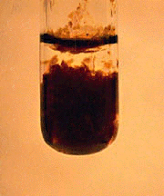
Fe²⁺ and Fe³⁺ In Aqueous Ammonia and NaOH:
Aqueous ammonia and NaOH reacts with Fe(II) ions to produce green ppt Fe(OH)₂,
which oxidizes to form red-brown Fe(OH)₃:
Insoluble in excess
Both Solutions React with Fe(III) ions to produce red-brown Fe(OH)₃:
Insoluble in excess

Slide 9
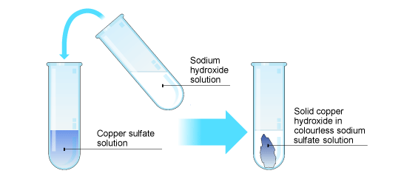
Copper (Cu²⁺)
Test with aqueous sodium hydroxide Solution
Light blue ppt. insoluble in excess

Slide 10
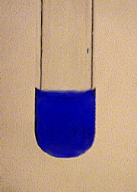
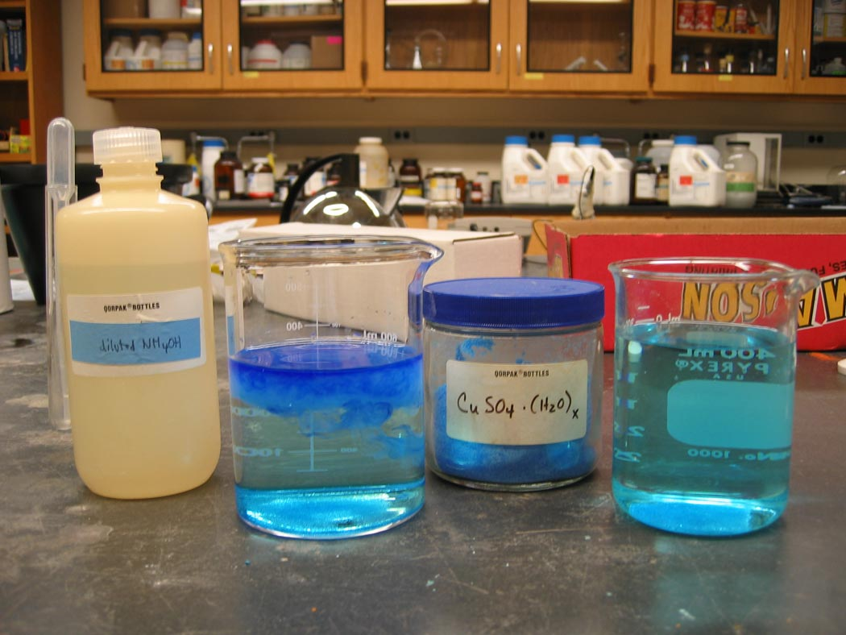
Copper (Cu²⁺)
Test with aqueous ammonia Solution
Light blue ppt. soluble in excess giving a deep-blue solution

Slide 11
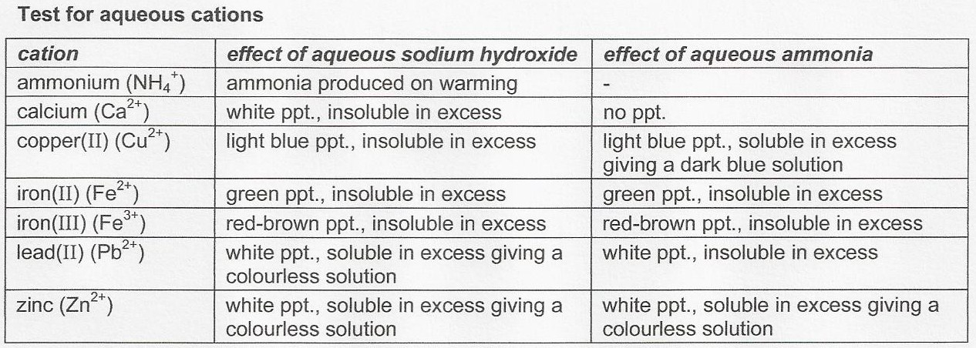
Test for Cations
Conclusion
Observations

Slide 12
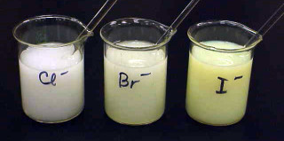
Halide tests (Cl⁻, Br⁻ ,I⁻)
The Acidified silver nitrate Test.
The test will give a white precipitate of silver chloride, a cream (off white) precipitate of silver bromide and a yellow precipitate of silver iodide.

Slide 13
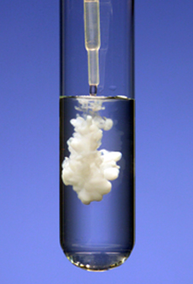
SULPHATE IONS.
The barium chloride test for sulphate (SO₄²⁻) ions.
Any soluble sulphate will give a white precipitate of barium sulphate.
The test is made in the presence of dilute hydrochloric acid to remove any carbonate or sulphite ions which may be present. These ions will also produce a precipitate which would confuse the results.

Slide 14
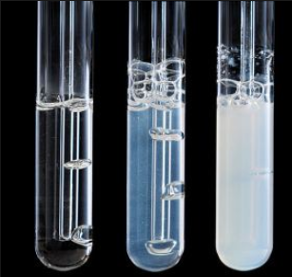
CARBONATE IONS.
ACID TEST
Any carbonate will produce carbon dioxide gas when
you add a dilute acid.
The carbon dioxide gas is identified using lime water, which goes milky

Slide 15
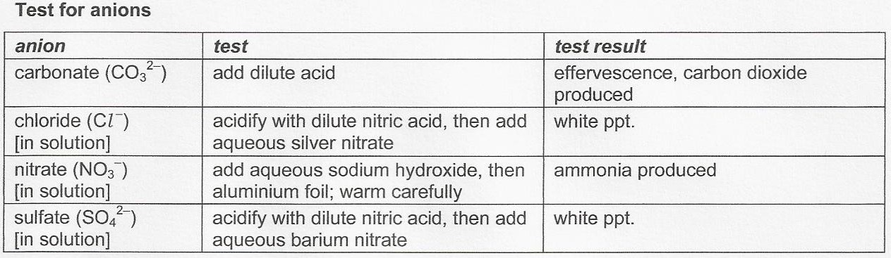
Test for Anions
Conclusion
Observations

Slide 16
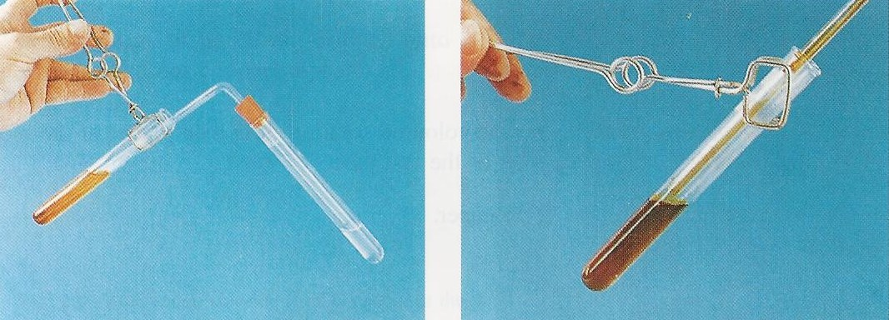
Test for Gases – Sulfur Dioxide (SO₂)
Observations : Effervescence observed.
Gas evolved turns aqueous acidified potassium dichromate (VI) from orange to green.
Conclusion : Sulfur dioxide gas is evolved.
Notes:
Sulfur dioxide is a reducing agent.
Sulfur dioxide turns aqueous acidified potassium manganate (VII) from purple (MnO₄⁻) to colourless (Mn²⁺).
Sulfur dioxide turns aqueous acidified potassium dichromate (VI) from orange (Cr₂O₇²⁻) to green (Cr³⁺).

Slide 17
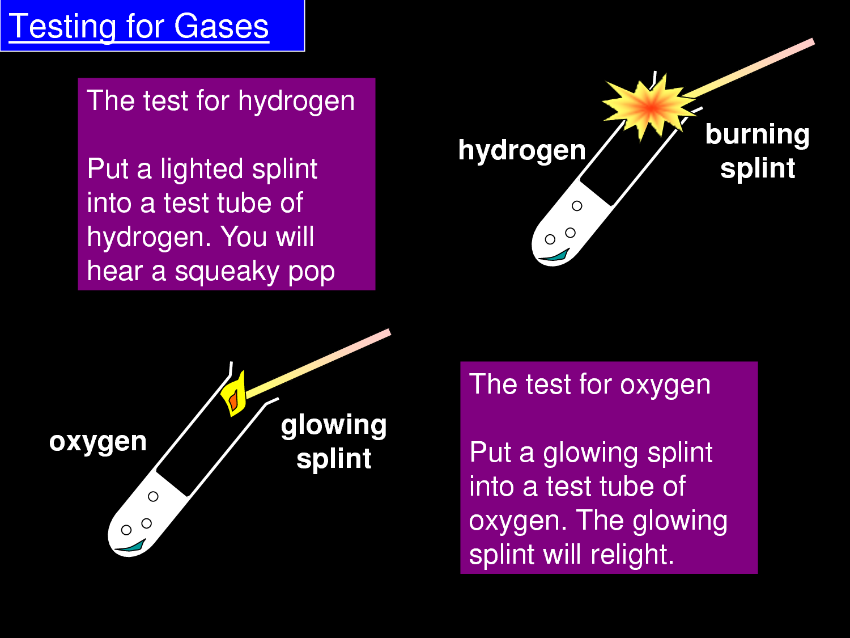

Slide 18
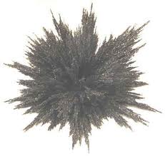
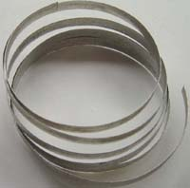
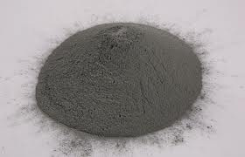
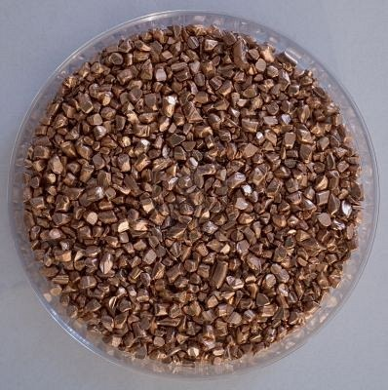

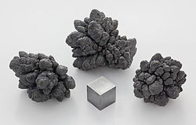
Common Metals
iron filings
magnesium ribbon
zinc powder
aluminium foil
lead
copper turnings

